Slide 1
Evaluation PhD XXXVIII cycle Bis March 2024
It consist of two-satge assessment
Annual report of the research, training and teaching activities carried out:
Title
Research activities carried out, and results attained
Formative activities attended
Teaching activities
List of publications (accepted and submitted publications)
2) Thesis proposal
Abstract (maximum 1000 characters)
Expected publications, in terms of number and type, with the expected timeline
Suggested sections (afted the mandatory ones):
Introduction and background
Objectives and impact
Materials and methods
Attained and expected results

Slide 2
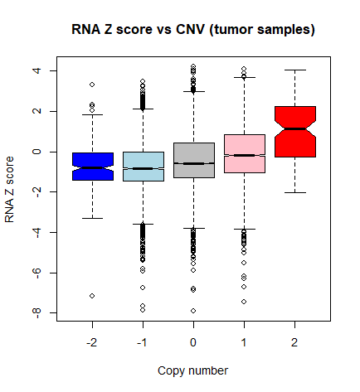
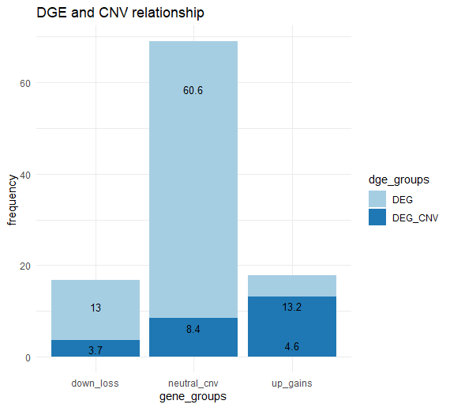
DGE and CNVs relationship (LUAD, TCGA)
Total genes tested: 31272
21 628
NO DEG
4066
5578

Slide 3
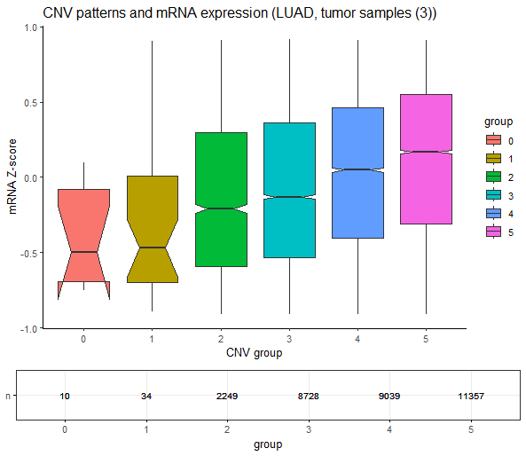
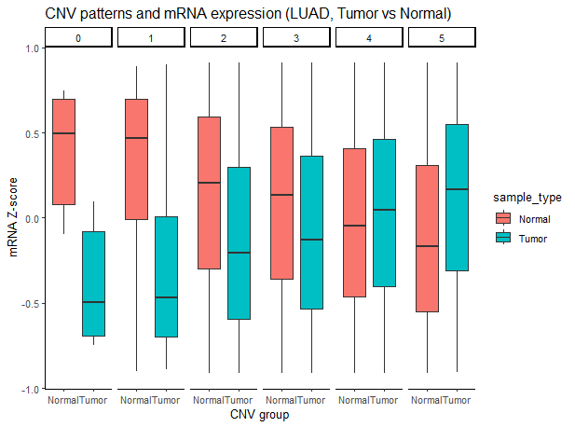
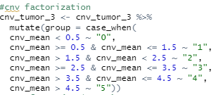
mRNA and CNVs relationship exploration (TCGA, LUAD)
Total genes tested: 31417, number of samples: 3
Notes:
Controllare Tumor & Normal Z-score, normalization part use TMP

Slide 4
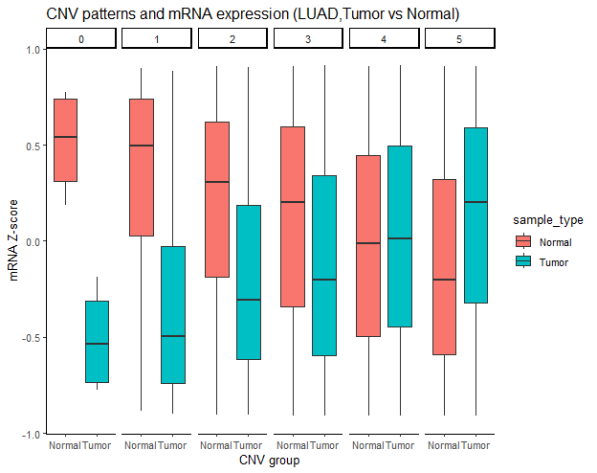
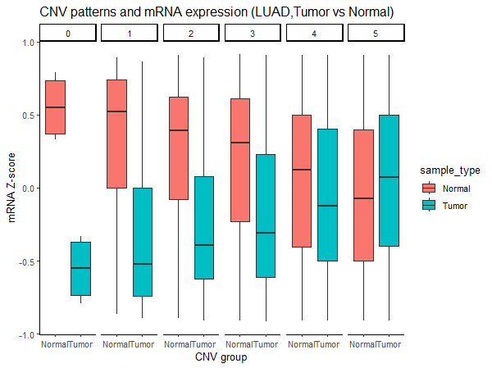
DeSeq2 :: rlog
TMP

Slide 5
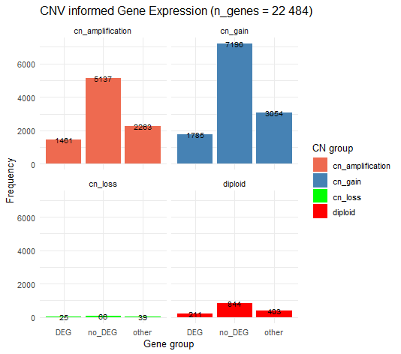
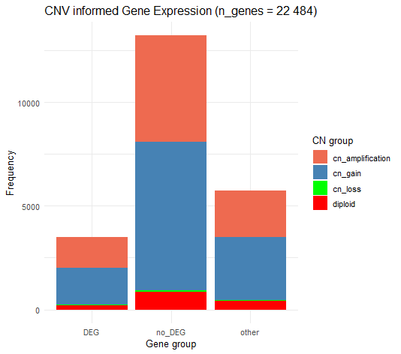
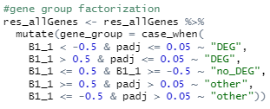
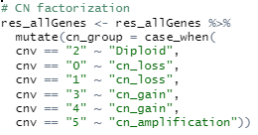
TCGA, LUAD
~ 55 % Dosage compensated genes
Notes:
https://rpubs.com/techanswers88/stackedbarcharts
no_DEG with CNV – dosage insensitive and dosage compensated > possible existence of dosage compensation mechanisms (mechanisms by which the expression of certain genes is modulated to compensate for differences in gene dosage)
55 % of genes are Dosage compensated.
Fare il filtro basato su quantile (20 %)

Slide 6
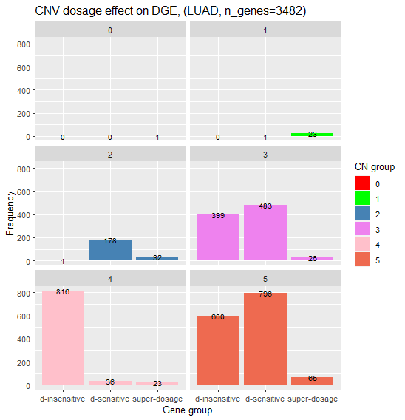
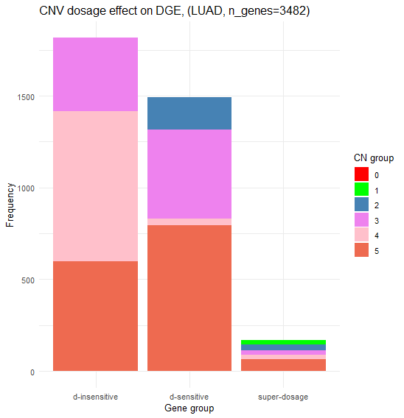
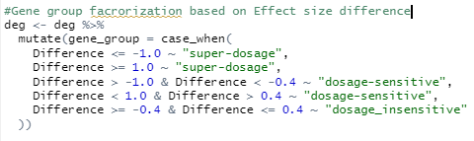
about 47 % (1664) of DE genes are explained by
the effect of CNV
Notes:
48 % DEGs are dosage sensitive genes explained by CNV effect.
Dosage reversed ? Many genes of group 3, 4 and 5 behave as dosage reversed > effect size difference positive, overcompensation

Slide 7
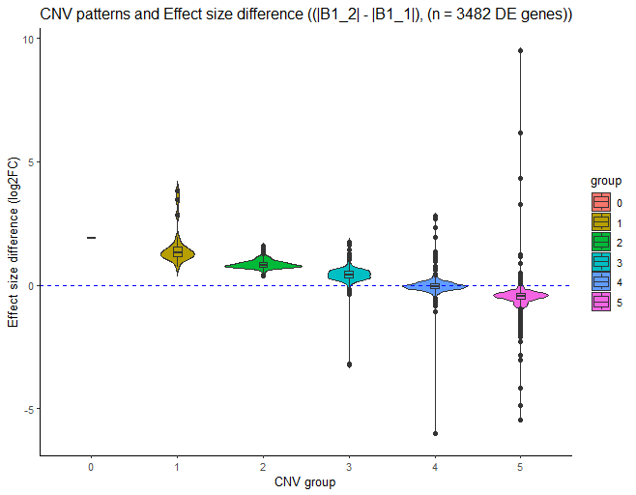
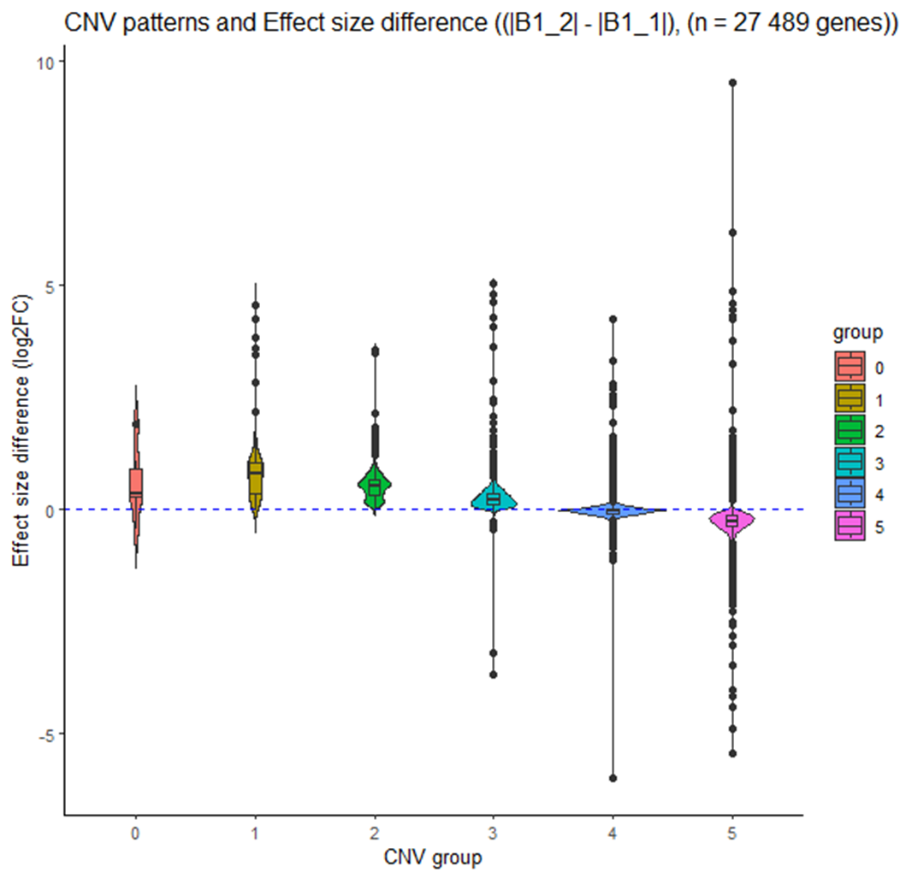

Slide 8
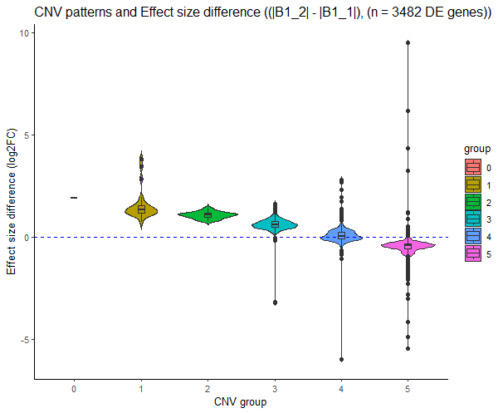
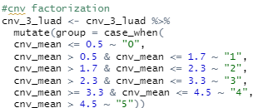
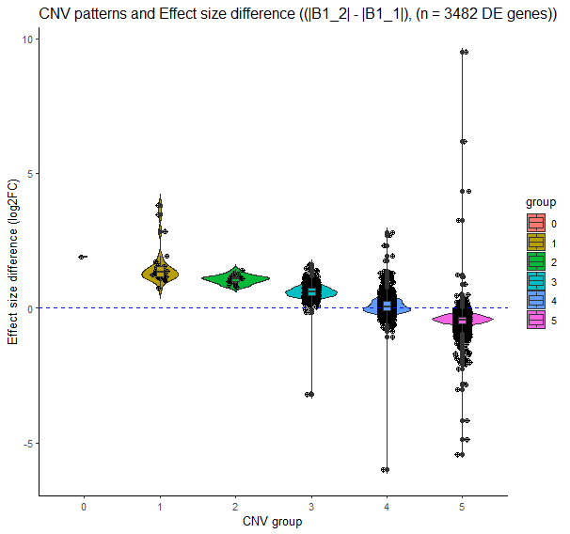

Slide 9
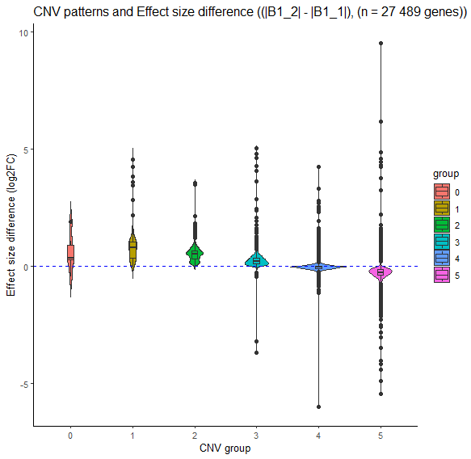
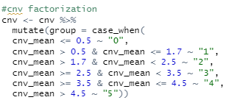

Slide 10
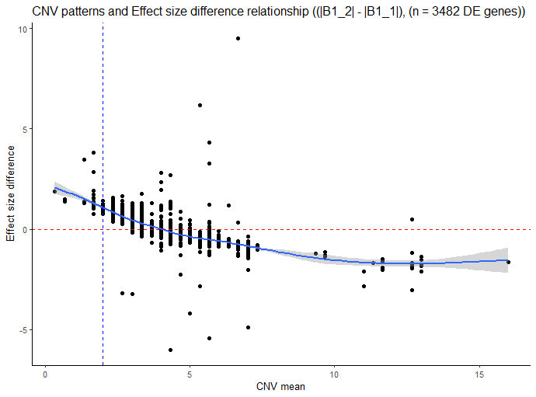
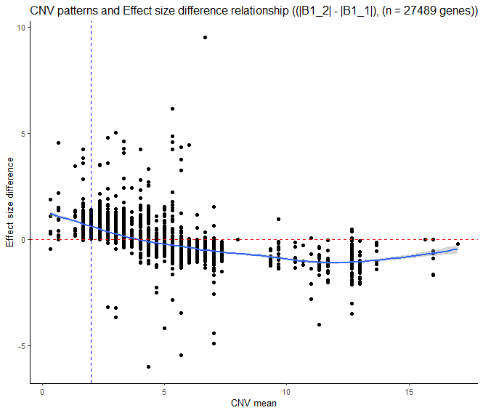

Slide 11
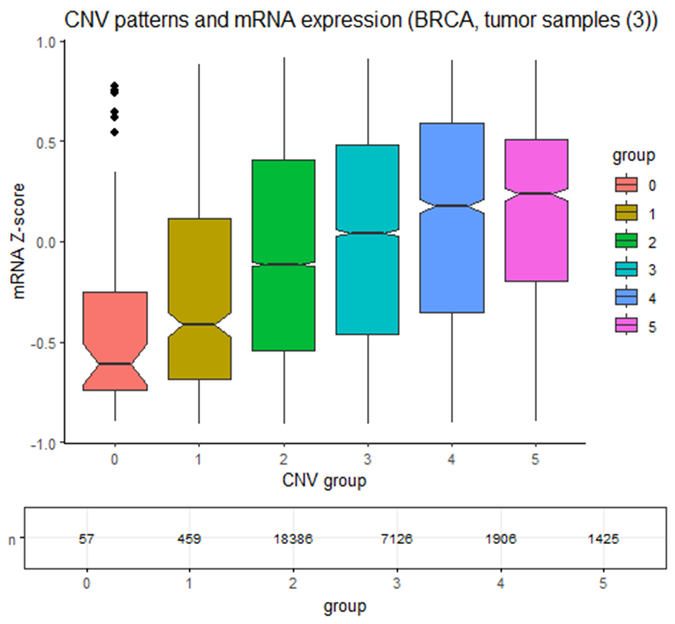
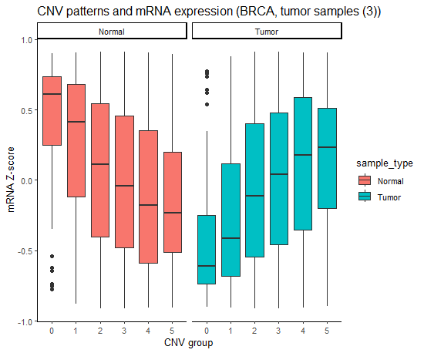
mRNA and CNVs relationship exploration (TCGA, BRCA)
Total genes tested: 29359, number of samples: 3

Slide 12
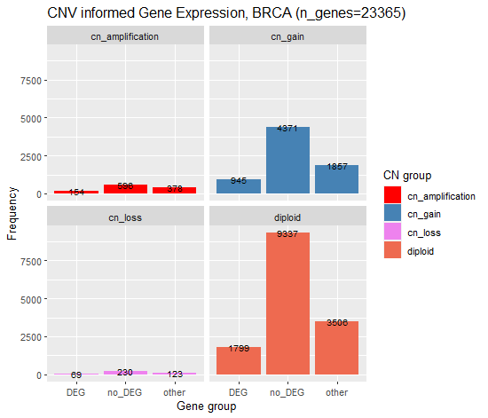
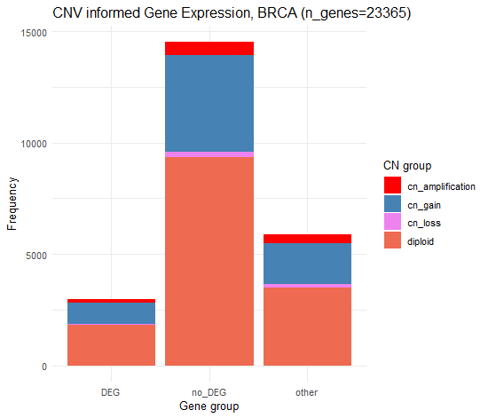
TCGA, BRCA
~ 22 % Dosage compensated genes
Notes:
22 % of genes are Dosage compensated.

Slide 13
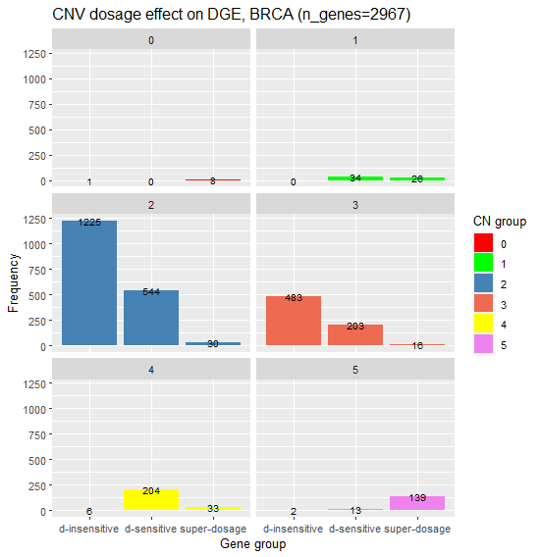
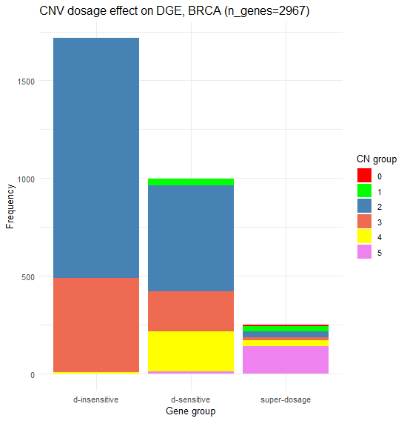
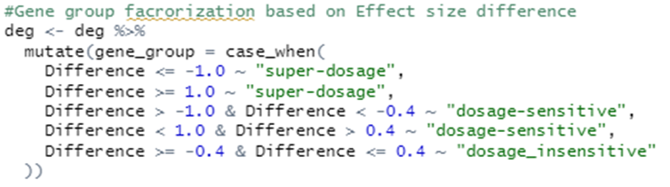
about 42 % (1250) of DE genes are explained by
the effect of CNV

Slide 14
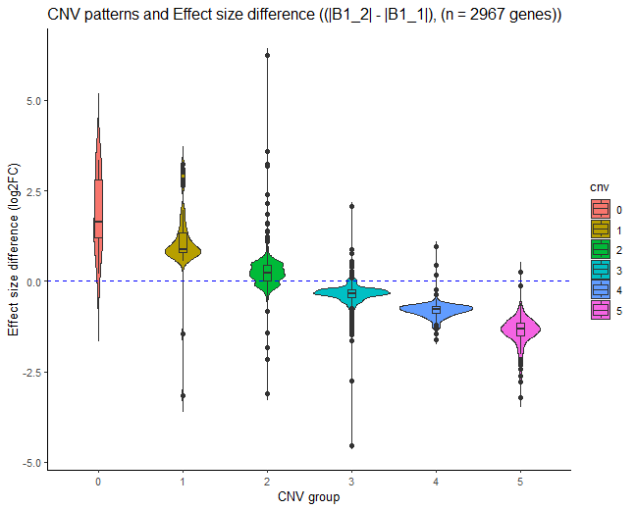
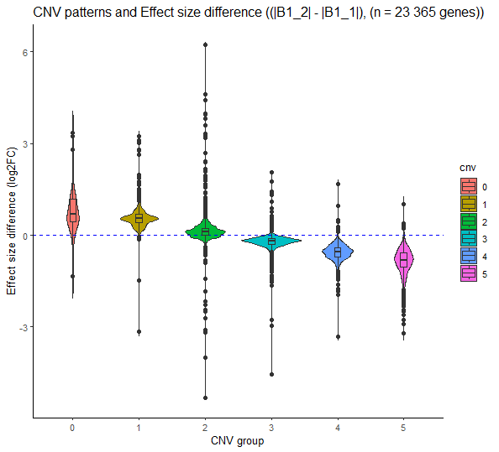
DEGs vs All tested genes, BRCA

Slide 15
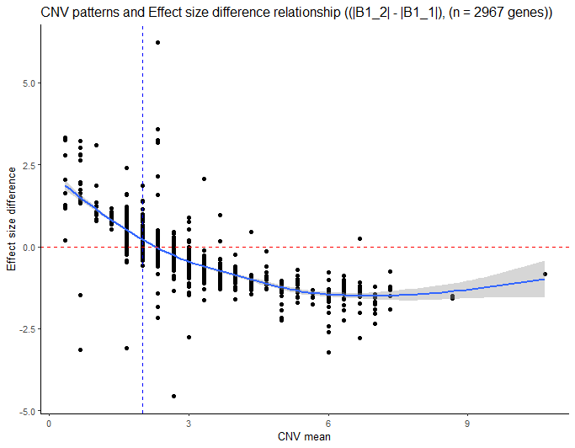
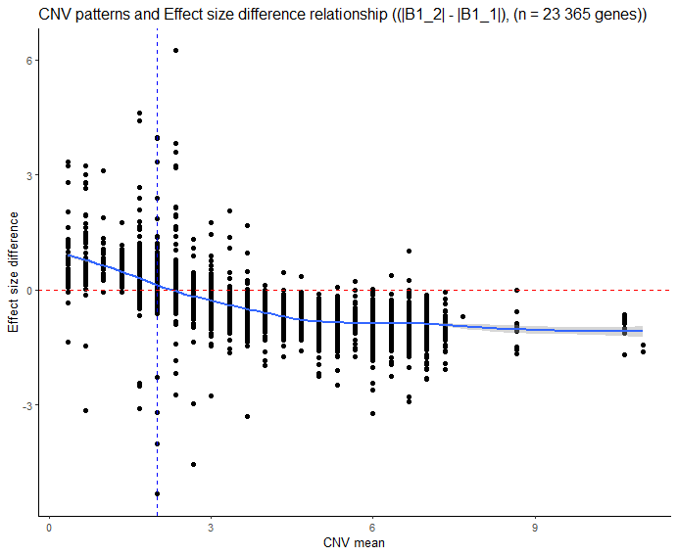

Slide 16
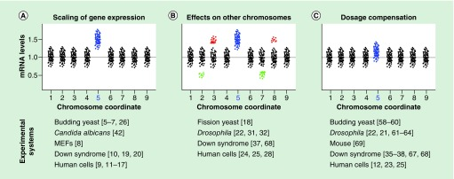
How aneuploidy shapes gene expression
- the mRNA levels do not appear to always scale with the gene copy number: hypothesis of gene dosage imbalance (dosage effect, dosage compensation, reverse dosage effect)
- 40% of the mRNA expression can be explained by variations in copy number
- challenge in analysis of tumors: karyotype heterogeneity of cancer cells intermixed with a fraction of diploid cells

Slide 17
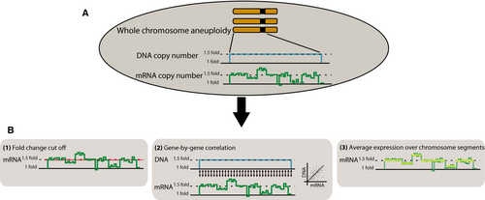
Methods usually applied
Correlation of gene copy number and mRNA expression

Slide 18
Effects of anauploidy on Gene Expression: https://febs.onlinelibrary.wiley.com/doi/10.1111/febs.13591
Gene Dosage Compensation: https://onlinelibrary.wiley.com/doi/full/10.1002/cam4.6719
Protein Dosage Compensation in human cancers: https://genome.cshlp.org/content/32/7/1254.full
Aneuploidy and Gene Expression:
https://www.ncbi.nlm.nih.gov/pmc/articles/PMC7132608/
Gaussian Mixture models:
https://scikit-learn.org/stable/modules/mixture.html
Dosage Sensitive genes in evolution and disease: https://bmcbiol.biomedcentral.com/articles/10.1186/s12915-017-0418-y
Gene dosage imbalance of human chromosome 21: Gene dosage imbalance of human chromosome 21 in mouse embryonic stem cells differentiating to neurons – ScienceDirect
Global gene dosage sensivity: Gene expression analysis identifies global gene dosage sensitivity in cancer | Nature Genetics
Uncoupling of gene expression from copy number: Uncoupling of gene expression from copy number presents therapeutic opportunities in aneuploid cancers - ScienceDirect
Study of Gene Dosage Compensation: Proteogenomic analysis of cancer aneuploidy and normal tissues reveals divergent modes of gene regulation across cellular pathways | eLife (elifesciences.org)
Gene normalization: https://translational-medicine.biomedcentral.com/articles/10.1186/s12967-021-02936-w
DGE workflow: https://nbisweden.github.io/workshop-RNAseq/1906/lab_dge.html

Slide 19
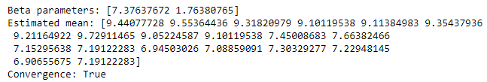
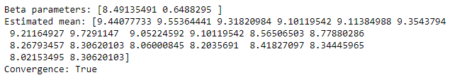
Model fitting on a single gene ≈
DeSeq2
LFC
K_{ij} ~ NB (µ_{ij} = mean, a_{i} = dispersion )
µ_{ij =} s_{j}q_{ij}
log(q_{ij}) = β_{0i} x_{0j} + β_{1i}x_{1j} + ɛ
MLE
DeSeq2 + CNV
log(q_{ij}) = β_{0i} x_{0j} * (cnv/2 + 10e-9)+ β_{1i}x_{1j}
cnv = [1,1,1,1,1,1,1,1,1,1,
3,2,2,4,4,2,3,3,3,4]
cnv = cnv + 10e-9
counts = counts * cnv
mu = β_{0i} x_{j0} * (cnv + 10e-9)+ɛ
mu ≠ β_{0i} x_{j0} * (cnv + 10e-9)+ɛ

Slide 20
Deciphering effect of anauploidy on DGE
Identify gene groups that exibit:
- super-dosage effect
- dosage effect (|B1_2 - B1_1| <=0.5 & >=0.5)
- dosage compensation effect
- dosage reversed genes ?
Compare 2 models
Look at diffrence between parameters B1_1 and B1_2
How to cluster gene dosage effects ?
Criteria to identify genes under Dosage compensation: difference between the RNA or protein log2FC with the DNA log2FC
Check normalization type
Notes:
Situation in which gene expression does not scale with gene copy number.
Cancer cells have shown incredible plasticity in adapting and overcoming stress: tolerance to high degree of aneuploidy.

Slide 21
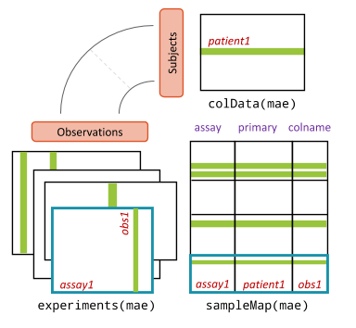
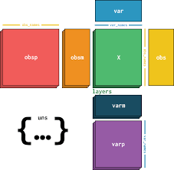
MultiAssayExperiment R
AnnData Python
(no support for multiple modalities)

